Slide 1
Multivariate Analysis of U.S. Homicide Data Patterns in Demographics, Weapons, and Crime Solvability
Presented by: Parth Maniar
Applied Multivariate Analysis
Summer 2025
July 18th 2025

Slide 2
Project overview
This presentation analyzes U.S. homicide data using PCA, clustering, and factor analysis to uncover key patterns.
Goals
Reveal hidden dimensions like age and case size (Dimension Reduction)
Explore weapon use, temporal trends, and race dynamics
Methods
PCA, K-means, Factor Analysis
Visualizations by gender, region, and ethnicity
Key Insights
Age and scale explain most variation
Weapon choice and victim profiles differ by gender
Strong same-race pairing in victim–offender relationships

Slide 3
Dataset Overview: U.S. Homicide Reports (1980–2014)
This dataset gives detailed records of homicide incidents reported to the FBI, including both solved and unsolved cases. It’s one of the most comprehensive public homicide databases available.
Dataset :- https://www.kaggle.com/datasets/murderaccountability/homicide-reports?resource=download
Key Variables:
Category | Variables
Demographics | victim_age,victim_sex,victim_race,perpetrator_age,perpetrator_sex, perpetrator_race
Counts | victim_count,perpetrator_count
Crime Details | weapon, crime_type, crime_solved
Location & Time | state, year
Ethnicity | victim_ethnicity, perpetrator_ethnicity
Relationship | relationship (between victim and perpetrator)

Slide 4
Data CleaNing
Column Renaming
Replaced spaces with underscores
Age Conversion
Transformed victim/perpetrator age fields to numeric
Filtering Invalid Entries
Clean, consistent, and structured
Standardized all names to lowercase (e.g., Record_ID → record_id)
Prepared age data for PCA and clustering
Removed unknowns in categorical fields (Gender, weapon, relationship)
Excluded ages ≤0 or >110
Dropped rows with victim_count or perpetrator_count < 1
Final Dataset
Ready for multivariate analysis

Slide 5
Principal Component Analysis(PCA)
Identify latent dimensions in homicide data by reducing complexity in numeric features.
⚙️ Methodology
Scaled numeric variables to standardize ranges
Applied PCA to extract key components
Visualized variance with scree plot and relationships with biplot

Slide 6

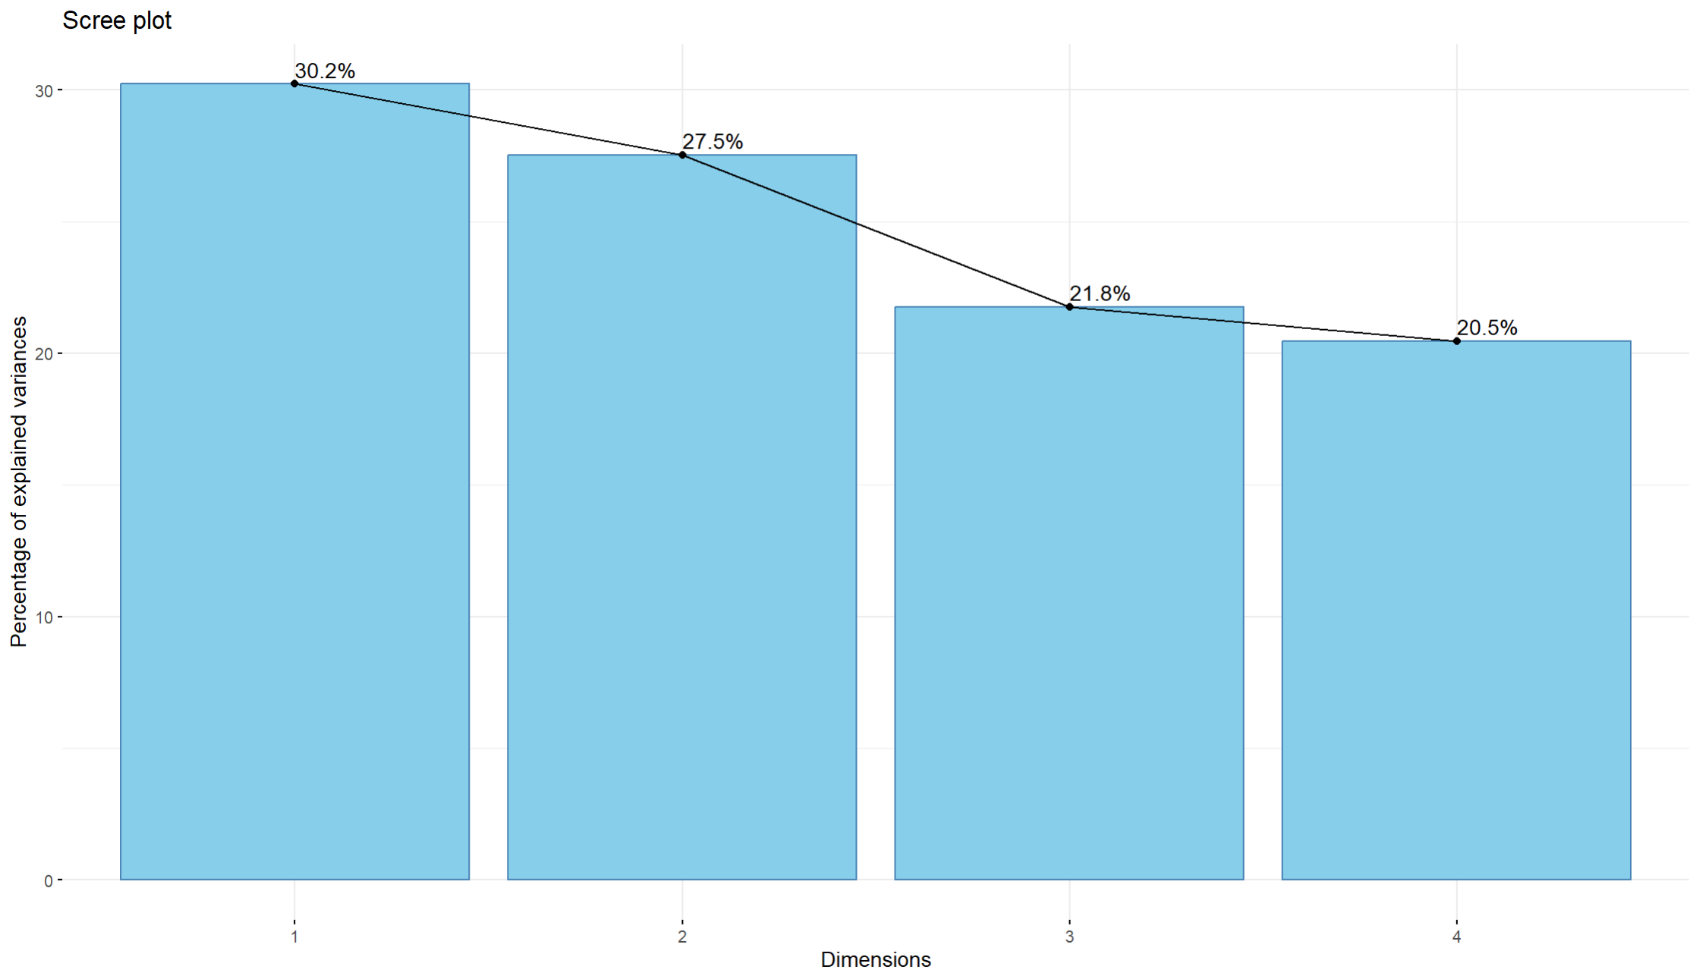
PCA – Scree Plot
Key Interpretation
PC1 explains ~30.2% of the variance
PC2 adds ~27.5%—together covering 57% total
Sharp drop after PC2 forms an “elbow,” confirming 2 components capture the essential structure
Retaining 2 dimensions balances interpretability and information preservation

Slide 7
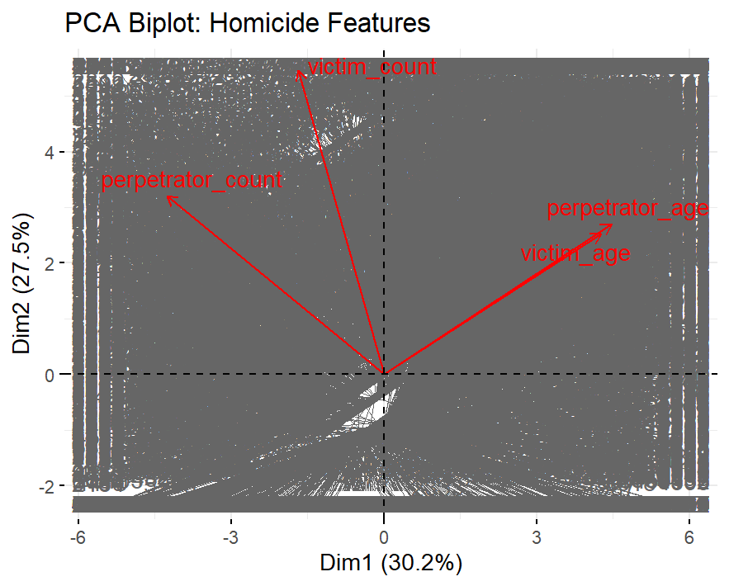
PCA – Biplot
PC1 (Horizontal Axis) → Age-driven variation
PC2 (Vertical Axis) → Scale of incidents (victim/perpetrator count)
Points in top-right quadrant reflect older victims and larger incidents
Points in bottom-left quadrant show younger ages and smaller cases
Biplot confirms that age and incident scale operate as independent dimensions

Slide 8
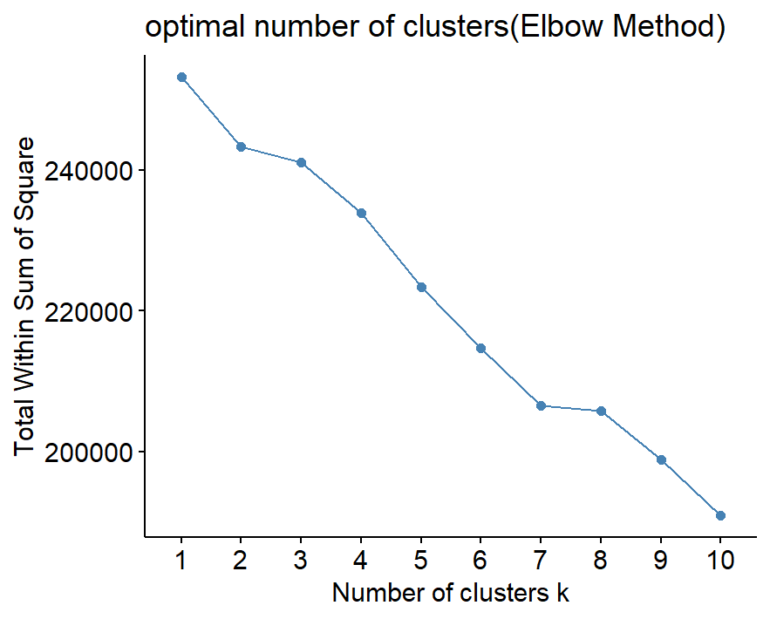
K-Means Clustering Analysis
Elbow Method Interpretation
Shows steep drop in within-cluster sum of squares from k = 1 to k = 2
Curve flattens after k = 2, forming a clear “elbow”
Indicates that 2 clusters balance structure and simplicity

Slide 9
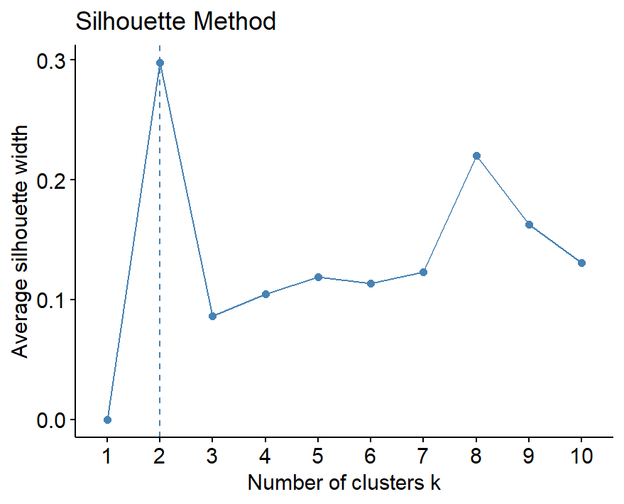
Silhouette Method Interpretation
Maximum average silhouette width observed at k = 2
Clusters are well-separated and internally cohesive
Higher values = stronger grouping structure
Conclusion: Both methods independently confirm that k = 2 is the most meaningful cluster solution for homicide case segmentation.

Slide 10
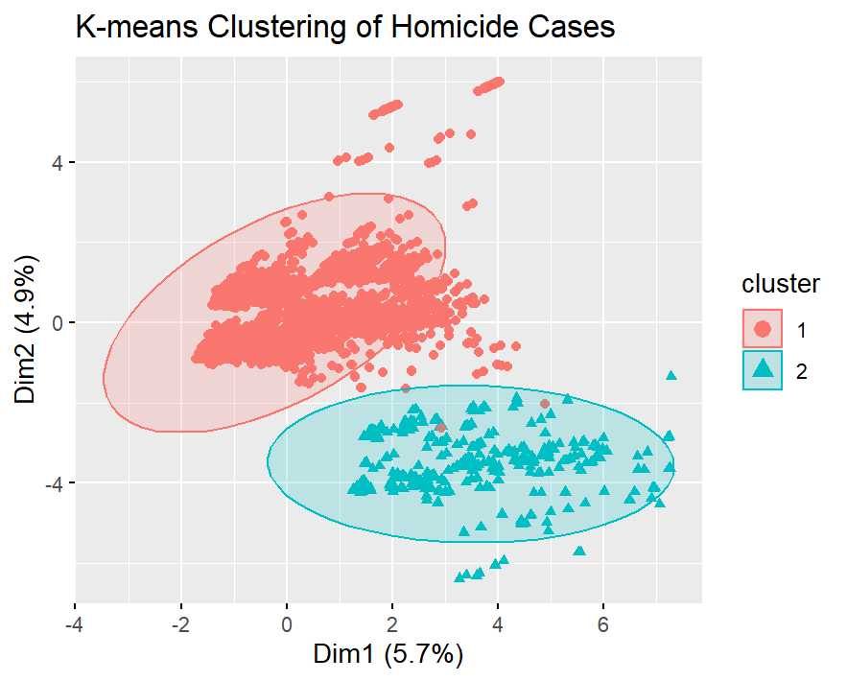
Cluster 1 (Red): Older individuals, higher victim/perpetrator counts
Cluster 2 (Teal): Younger profiles, smaller-scale incidents
Ellipses show strong separation and cohesion within each group
Confirms earlier PCA findings: age and case scale are key dimensions

Slide 11
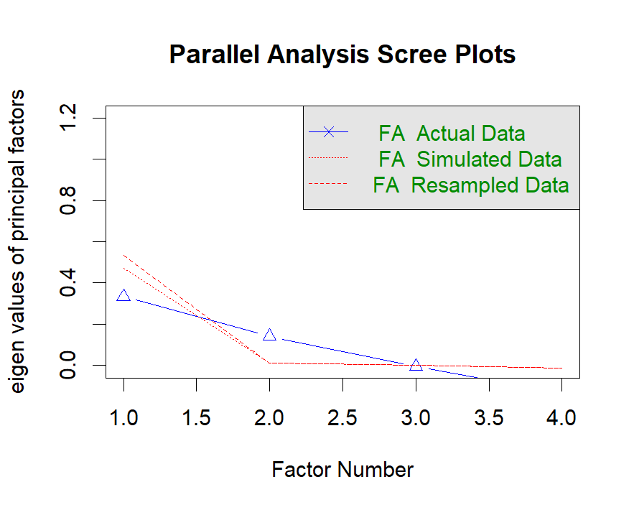
Factor analysis
Factor analysis revealed two hidden dimensions: Age (victim/perpetrator) and Case Scale (number of people involved).
Parallel scree plot confirmed that these two factors explain the most meaningful variation in homicide data.

Slide 12
Factor Loadings
Factor Loadings Matrix
Variable | ML1 | ML2
victim_age | 0.297 | -
perpetrator_age | 0.486 | -
victim_count | - | 0.399
perpetrator_count | -0.179 | 0.368
Factor Summary Statistics
Metric | Factor 1 (ML1) | Factor 2 (ML2)
SS loadings | 0.362 | 0.296
Proportion Var | 0.091 | 0.074
Cumulative Var | 0.091 | 0.165

Slide 13
Factor analysis confirms two distinct underlying patterns:
ML1 (Age Factor) is driven by victim and perpetrator age, capturing 9.1% of variance
ML2 (Case Scale Factor) reflects incident size via victim/perpetrator count, explaining 7.4%
Together, they account for 16.5% of the data’s variation and align with PCA insights.

Slide 14
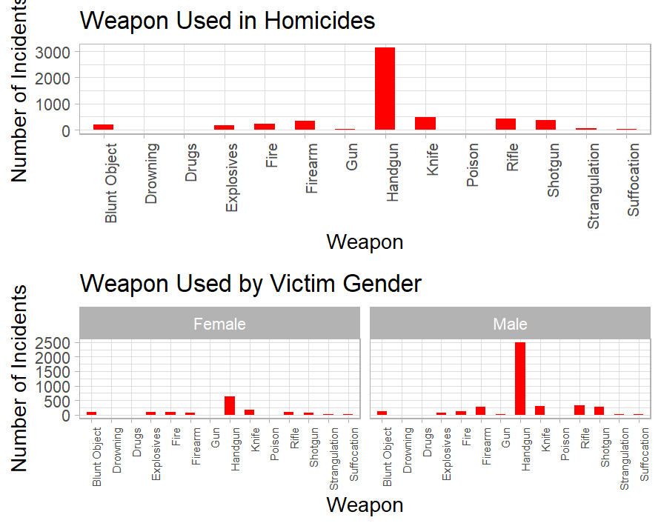
Exploratory Visualizations

Slide 15
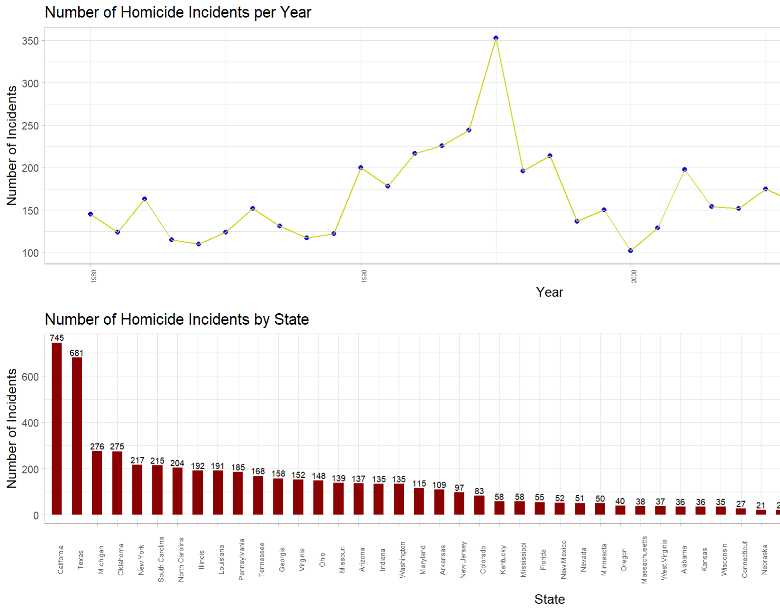

Slide 16
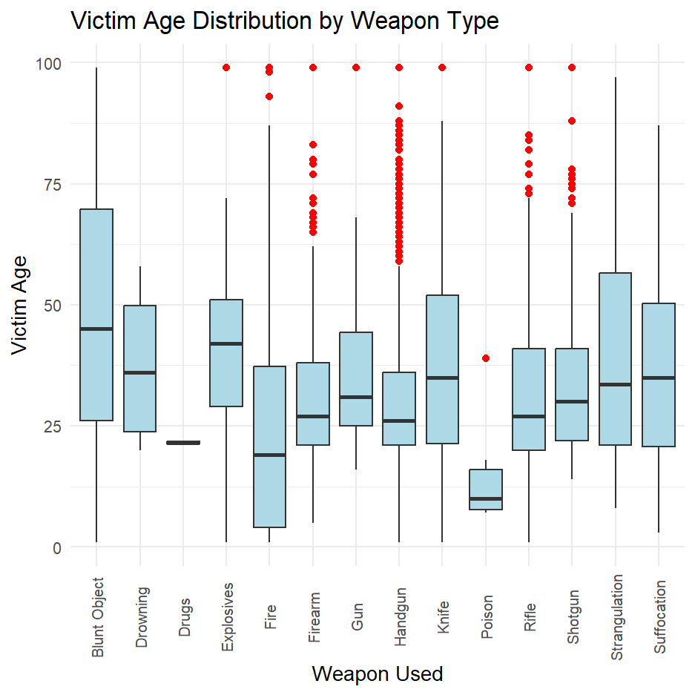

Slide 17
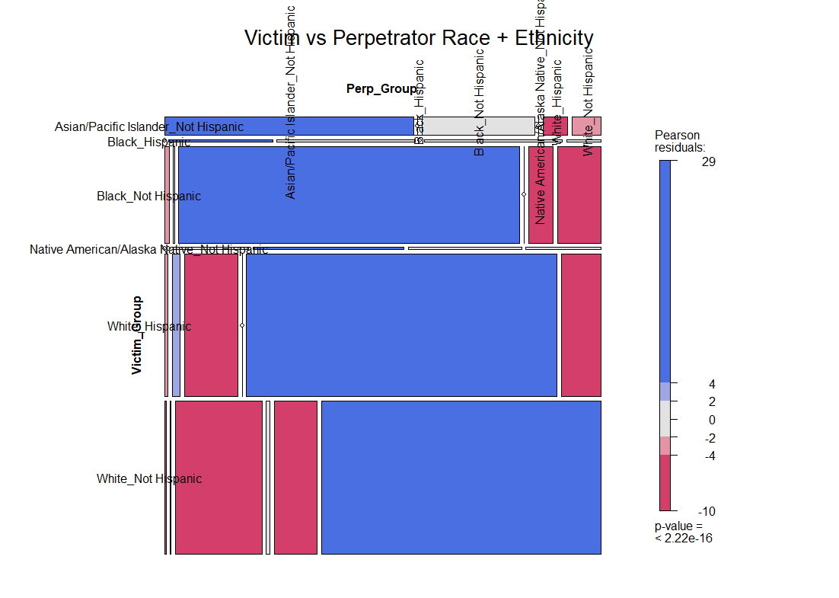

Slide 18
Multivariate Insights – Final Takeaways
Latent Dimensions
Age and incident scale explain 16.5% of data variation
Clear split between younger/small-scale and older/large-scale homicide clusters
Temporal & Geographic Trends
Homicide rates peaked in the mid-1990s, then declined
California and Texas consistently report the highest counts
Weapon Usage Patterns
Handguns dominate overall
Women face close-range weapons (knives, strangulation)
Men face broader firearm types
Weapon choice influences victim age distribution: strangulation skews older, poisoning skews younger
Racial Dynamics
Strong same-race victim–perpetrator pairings
Cross-race incidents are relatively rare

Slide 19

Thank You!
Question?

